Slide 1


Final Project Presentation
MedGuardian: AI-Powered Early Disease Detection System.
Submitted By:
Om Singh Chauhan
KID: K24404 | BCA (DS)
School of Computer Applications,
Career Point University, Kota
Under Supervision:
Karthikeyan C Sir
Vcodez Innovation Ideas,
Chennai , Tamil Nadu - 600119

Slide 2
Contents
Introduction
Key Problems in Healthcare
Core Objectives
System Overview
Important Features (Highly Explained)
Dashboard & Analytics
PDF Report Generation
Authentication System
Technology Stack
Use Cases
Conclusion
www.vcodez.com

Slide 3
Introduction
Healthcare systems often struggle with early diagnosis, inaccurate manual analysis, and poor record management. Patients usually do not have access to previous medical reports, making historical comparison and timely treatment difficult.
MedGuardian is an AI-enabled medical assistance platform that predicts diseases using machine learning models and securely manages patient records through a MySQL database. The system provides digital PDF reports, analytical dashboards, login-based access control, and automated comparison of historical test data.
The project bridges the gap between modern medical diagnostics and digital healthcare by integrating artificial intelligence, cloud-based storage, and an interactive user interface.
www.vcodez.com

Slide 4
Problem Statement
Traditional healthcare reporting systems face several issues:
Manual diagnosis is time-consuming and prone to errors.
Lack of historical data makes it difficult for doctors to compare old and new health reports.
Medical records are often lost or poorly stored.
No unified system exists for disease prediction, report generation, and data management.
Current tools do not provide risk evaluation or visual analytics.
There is a need for a robust AI-driven system that can predict diseases, generate professional medical reports, store data securely, and provide comparison-based analytics.
www.vcodez.com

Slide 5
Core Objectives
• Develop ML-based disease prediction models
• Maintain secure login & data protection using MySQL
• Store all tests + reports permanently
• Provide edit/delete control for record management
• Offer trend analysis with graphical comparison
www.vcodez.com

Slide 6
Important Features
1. Disease Prediction Engine:
• Predicts Heart, Kidney & Diabetes diseases.
• Uses trained ML models for accuracy.
2. Data Storage (MySQL):
• Saves every test, report, and patient detail permanently.
• Supports future retrieval and comparison.
3. Edit & Delete Records:
• Modify old data if there is an error.
• Delete unnecessary or outdated reports.
• Maintains clean and accurate
www.vcodez.com

Slide 7
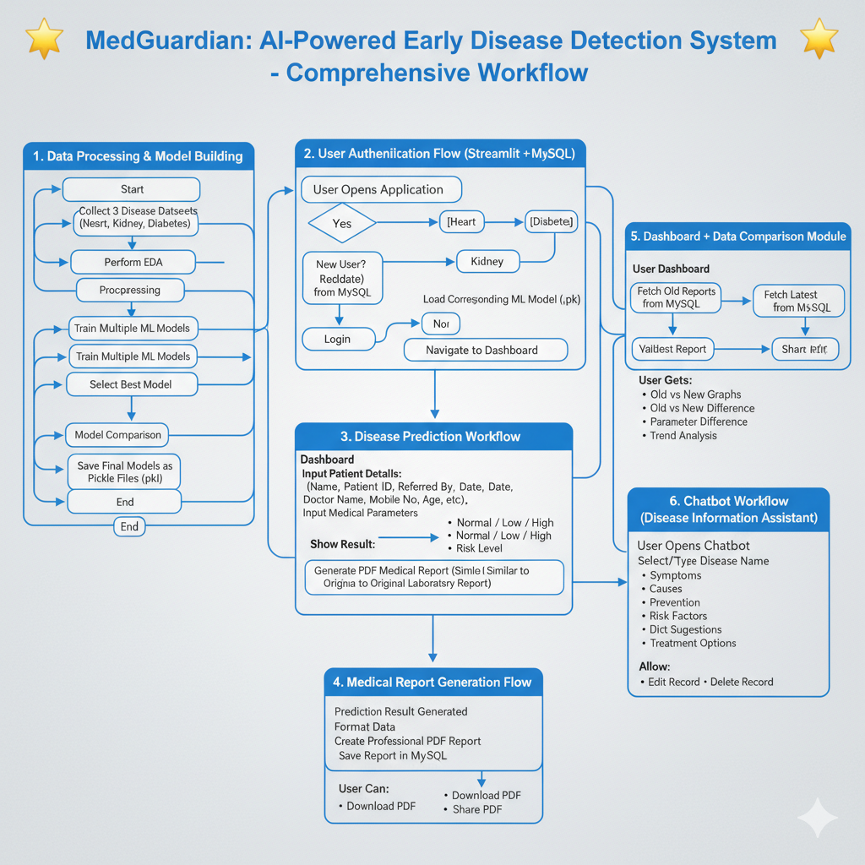
Important Features (Highly Explained)
www.vcodez.com

Slide 8
Trend Comparison Module
Compares old vs new test values dynamically.
Shows improvement or risk increase.
Visual graphs help doctors make better decisions.
Works for all diseases stored in system.
www.vcodez.com

Slide 9
Dashboard & Analytics
  Interactive charts with Plotly
  Date & disease-wise filters
  Risk-level indicators (Low, Medium, High)
  Summary statistics of all patients
www.vcodez.com

Slide 10
PDF Report Generation
Automatically creates a professional medical report
Includes test values, prediction, risk score
Doctor name + patient details auto-filled
Stored permanently in database for future use
www.vcodez.com

Slide 11
Authentication System
Login/Registration using MySQL
Password hashing for security
Role-based access (Admin)
Only authorized users can view/edit/delete records
www.vcodez.com

Slide 12
Technology Stack
Frontend: Streamlit
Backend: Python
ML: Numpy, pandas, Matplotlib, Scikit-learn etc
Database: MySQL
Reporting: ReportLab PDF Engine
Visualization: Plotly
www.vcodez.com

Slide 13
Use Cases
Hospitals & Clinics
Diagnostic Laboratories
Telemedicine Platforms
Medical Colleges & Research Centers
www.vcodez.com

Slide 14
Conclusion
MedGuardian is a complete AI-driven healthcare system that:
            ✔ Predicts diseases accurately
            ✔ Stores detailed medical records
            ✔ Generates professional reports
            ✔ Allows edit/delete data operations
            ✔ Provides visual analytics and comparisons
A modern solution for next-generation healthcare.
www.vcodez.com

Slide 15

www.cpur.in

